Slide 1
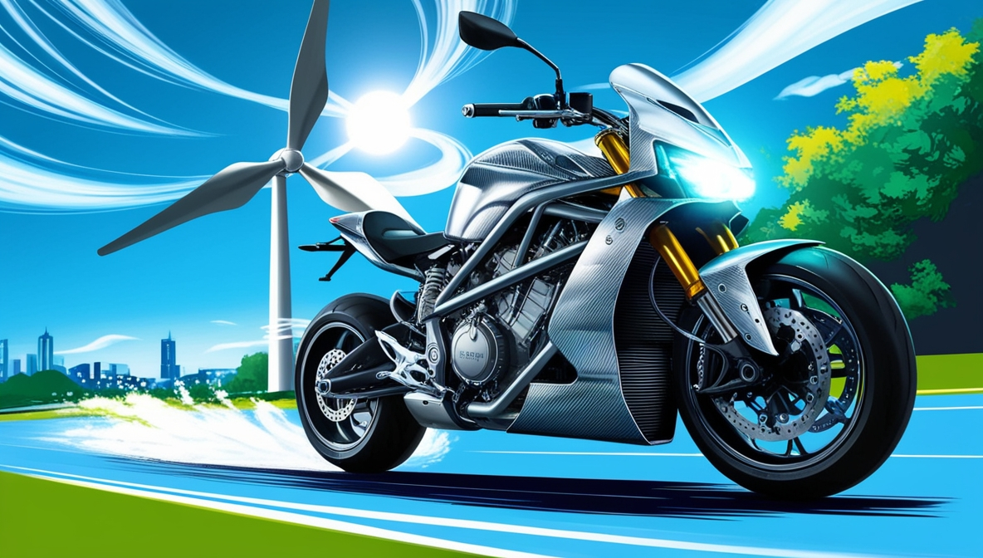
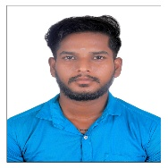



Wind Regenerative System for EV Charging Using Air Pressure
Author 1
Photo
Author 2
Photo
Author 3
Photo
Author 4
Photo
Vasanthan
ThiruKumaran
GuruPrasath
Yogesh
Sri Venkateshwaraa College of Engineering And Technology
Puducherry
Saranya Vadivelu

Slide 2
Challenge Statement
How might we efficiently integrate turbine systems into vehicles to generate electricity without compromising vehicle performance, aerodynamics, or energy efficiency, while harnessing waste energy from natural airflow, mechanical motion, or underutilized systems

Slide 3
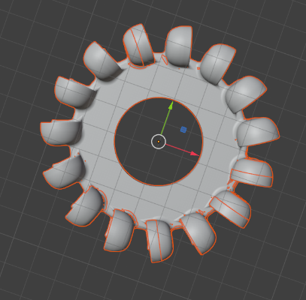
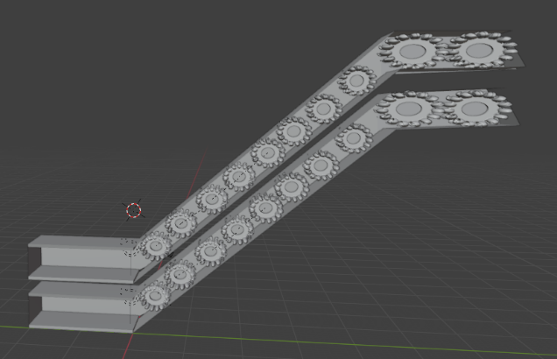
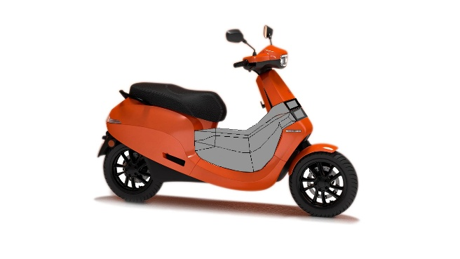
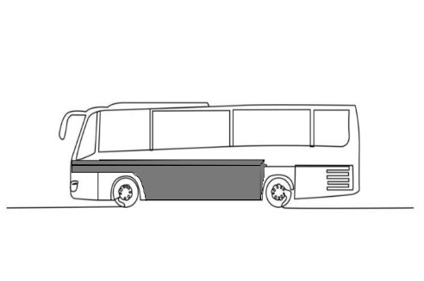
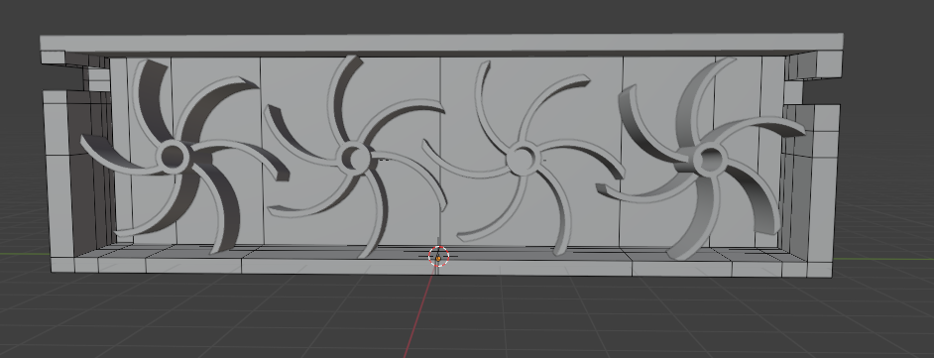
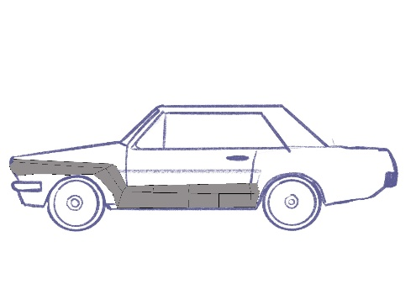
Concept / Solution

Slide 4
Pros and Cons of the solution
Pros
Cons
. Energy Recovery
Turbines can help harness wasted kinetic energy or airflow to generate electricity, particularly when vehicles are moving at high speeds.
implementation on electric scooters or EVs, the recovered energy can recharge the battery, increasing range.
2. Eco-friendly Solution
By producing electricity from renewable motion or wind (aerodynamic drag), it promotes sustainable energy.
Reduces dependence on external power sources for electric vehicles.
3. Extended Battery Life
recharging the batteries while driving reduces the frequency of charging stations usage.
4. Innovative Hybrid Systems
Adding turbines as auxiliary power sources allows a vehicle to operate in hybrid mode, combining traditional batteries and turbine-generated electricity.
5. Useful During High Speeds
Vehicles moving on highways or in consistent motion (e.g., scooters, buses, or cars) produce more wind or mechanical force, making the turbines more efficient.
1. Increased Aerodynamic Drag
For air turbines mounted externally (on buses or cars), wind resistance increases, negatively impacting fuel efficiency or energy consumption restricting vechiles free movement.
2. Added Weight and Complexity
Introducing turbines adds weight to the vehicle and increases mechanical complexity, which might offset the energy gains.
For lightweight vehicles (e.g., scooters), the extra load can reduce performance.
3. Inefficiency at Low Speeds
Turbines require consistent airflow or motion. At low speeds or idle stops, the turbines would generate little to no power.
For city traffic, with frequent stopping, turbines might not be effective.
4. Cost of Implementation
Manufacturing and installing turbines might increase vehicle costs.
Maintenance and repairs for turbines add to the long-term cost burden.
5. Energy Loss (Not Perpetual Motion)
Due to the laws of thermodynamics, extracting energy via turbines might draw power from the main system, making vehicles work harder and negating benefits.
Systems aren't 100% efficient, and energy loss in the process might outweigh the gains.

Slide 5
Technical Description
Turbine Design
Turbine Blades: Multi-bladed turbines are shown, designed to capture maximum airflow while minimizing energy loss and drag.
Arrangement:
In the image, turbines are placed in series within a linear duct or frame, allowing airflow to pass through multiple blades sequentially.
These can be used under vehicle bodies where airflow is concentrated through channels.
Placement and Implementation
For two-wheelers (e.g., scooter): The turbine can be installed just above the battery Compartment at which airflow can be made to pass through chambers.
For buses and cars: Larger turbines can be integrated into undercarriages, or through ducts in strategic zones where airflow or vehicle motion generates natural turbulence.
A multi-turbine array, as depicted in the image, maximizes energy recovery over a larger airflow area.
Energy Capture Mechanism
The spinning turbines convert mechanical rotational energy into electricity through attached generators.
Small-scale alternators are linked to turbines to produce low-voltage output, which can charge auxiliary batteries, capacitors, or power onboard electrical systems such as lights, sensors, and fans.

Slide 6
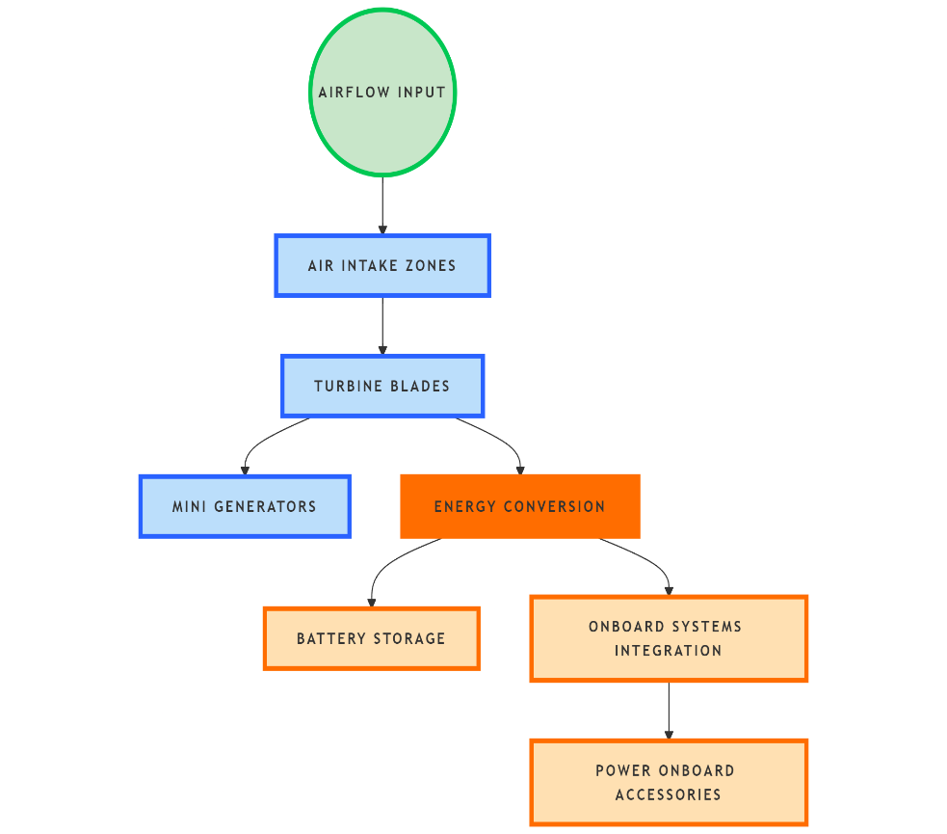
Implementation Plan
Feasibility Study:
Analyze high-velocity airflow zones in vehicles
Define energy targets based on system requirements.
Design & Prototyping:
Turbine blade design (3D modeling + CFD simulation).
Identify optimal placement for minimal drag.
Build lightweight prototypes with generators.
System Integration:
Connect turbines to mini generators for electricity conversion.
Integrate output into batteries or systems via regulators.
Add sensors for real-time performance monitoring.
Testing & Optimization:
Wind tunnel & on-road testing to validate power output.
Refine blade design, placement, and efficiency.
Scaling & Deployment:
Modular components for scooters, cars, and buses.
Pilot trials for real-world validation.
Market as a sustainability-focused product.

Slide 7
Validation / Testing / Analysis

Slide 8
Cost Estimate
Item | Unit Cost (INR) | Notes
Turbine + Mounts | ₹5,000 – ₹20,500 | Lightweight, scalable design
Micro-generator | ₹6,500 – ₹25,900 | Compact, efficient design
Electronics & Wiring | ₹4,300 – ₹10,900 | Controllers, voltage stabilizers
Integration | ₹6,300 – ₹12,600 | Labor + vehicle adaptation cost
Total Per Unit | ₹45,600 – ₹1,07,900 | Cost reduces with scale (~20% drop)

Slide 9
Assumptions

Slide 10
References
Electromagnetic suspension : https://nevonprojects.com/power-generation-using-electromagnetic-suspension/
https://sustainenergyres.springeropen.com/articles/10.1186/s40807-020-00062-7
https://www.sciencedirect.com/science/article/abs/pii/S2213138822002910

Slide 12
Guidelines
Do not use more than 15 slides.
Do not give any theoretical fundamentals.
Illustrate with suitable means such as drawings, examples, algorithms, flow chart etc.
Use a consistent format.
Check for spelling and grammar – ensure no errors (spell check).
Highlight the major advantages of the technique/method proposed when compared with other techniques or conventional techniques.
While uploading the PPT file, rename first 4 letters (i.e., 0000) with your PID nos.

